Slide 1
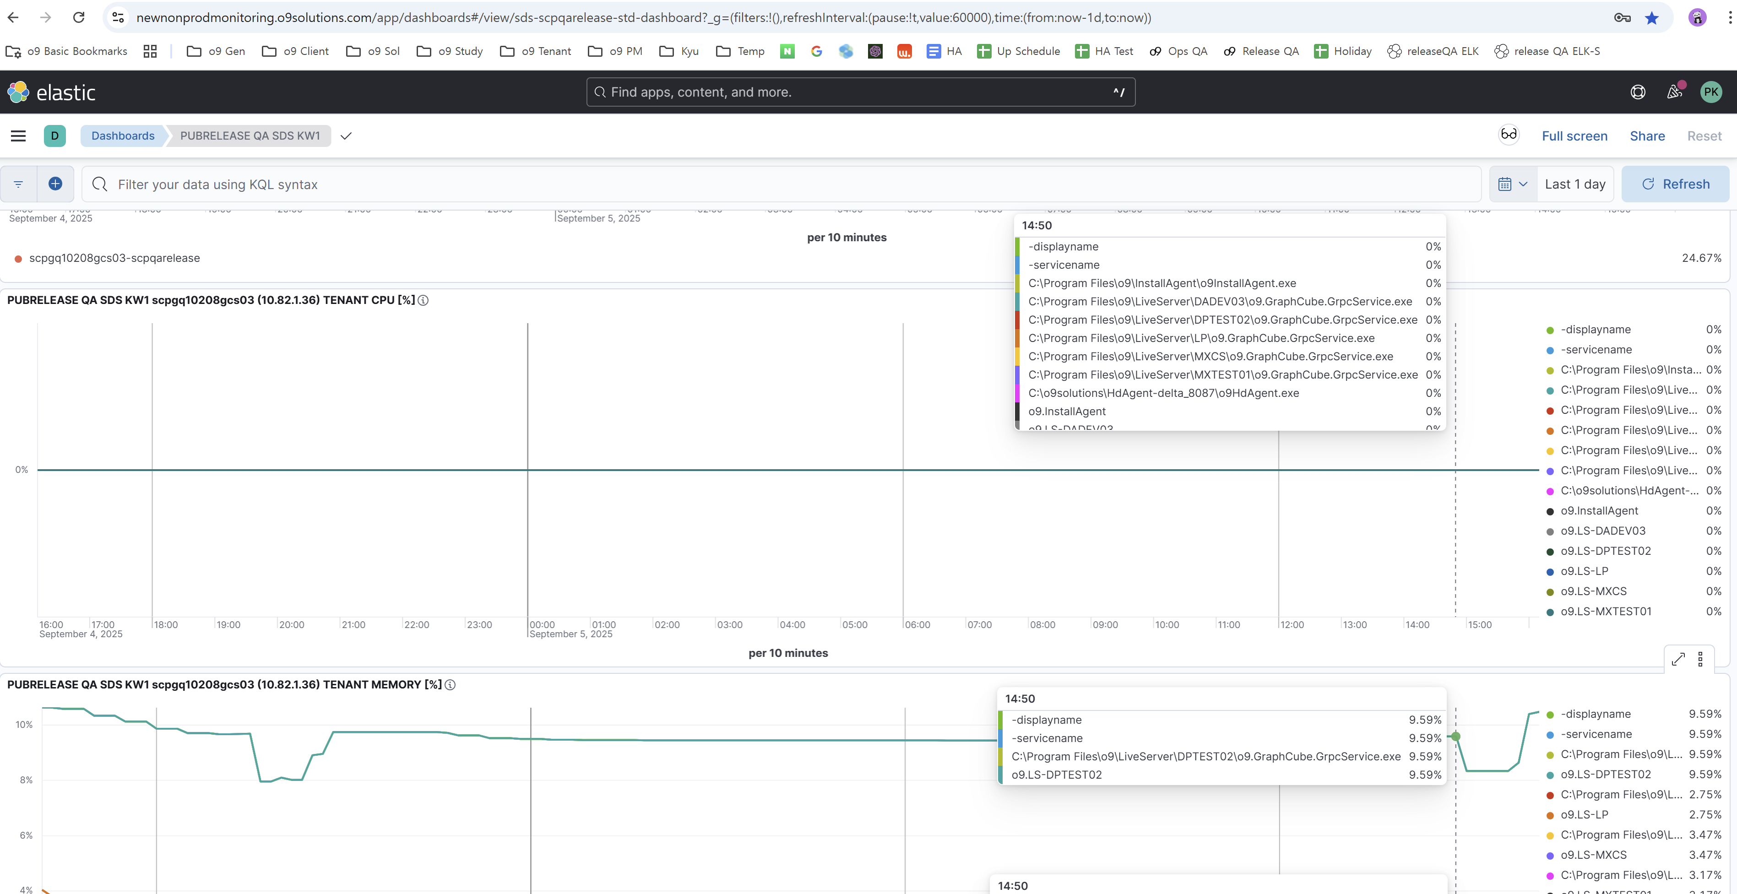
PUBRELEASE QA SDS KW1
Please remove ‘displayname, servicename and c:\Program Files … . As it indicates the same information as tenant name

Slide 2
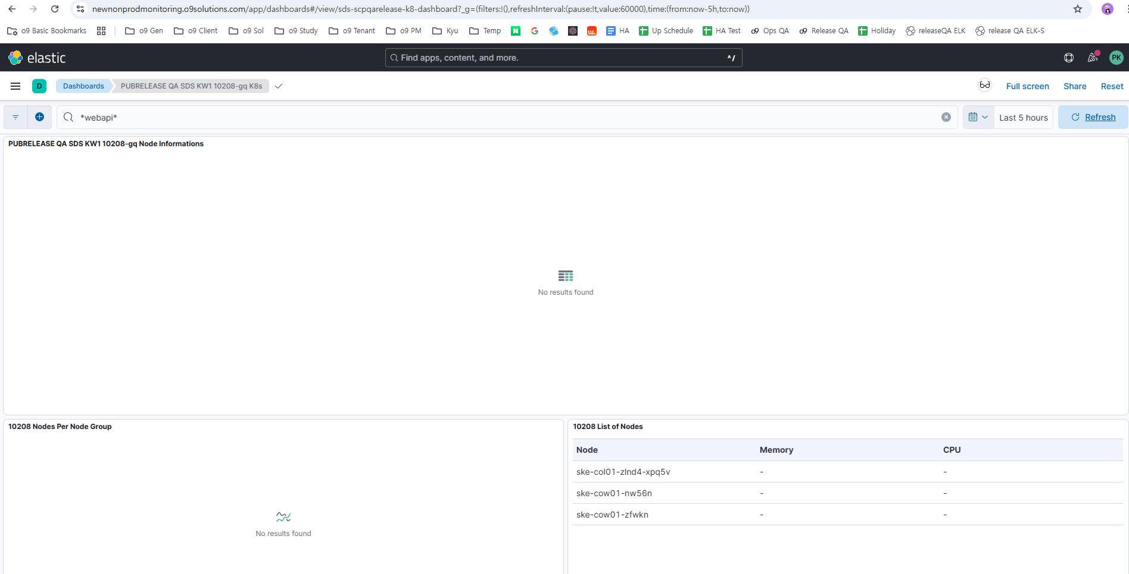
PUBRELEASE QA SDS KW1 10208-gq K8s
Please complete the dashboard on this UI

Slide 3
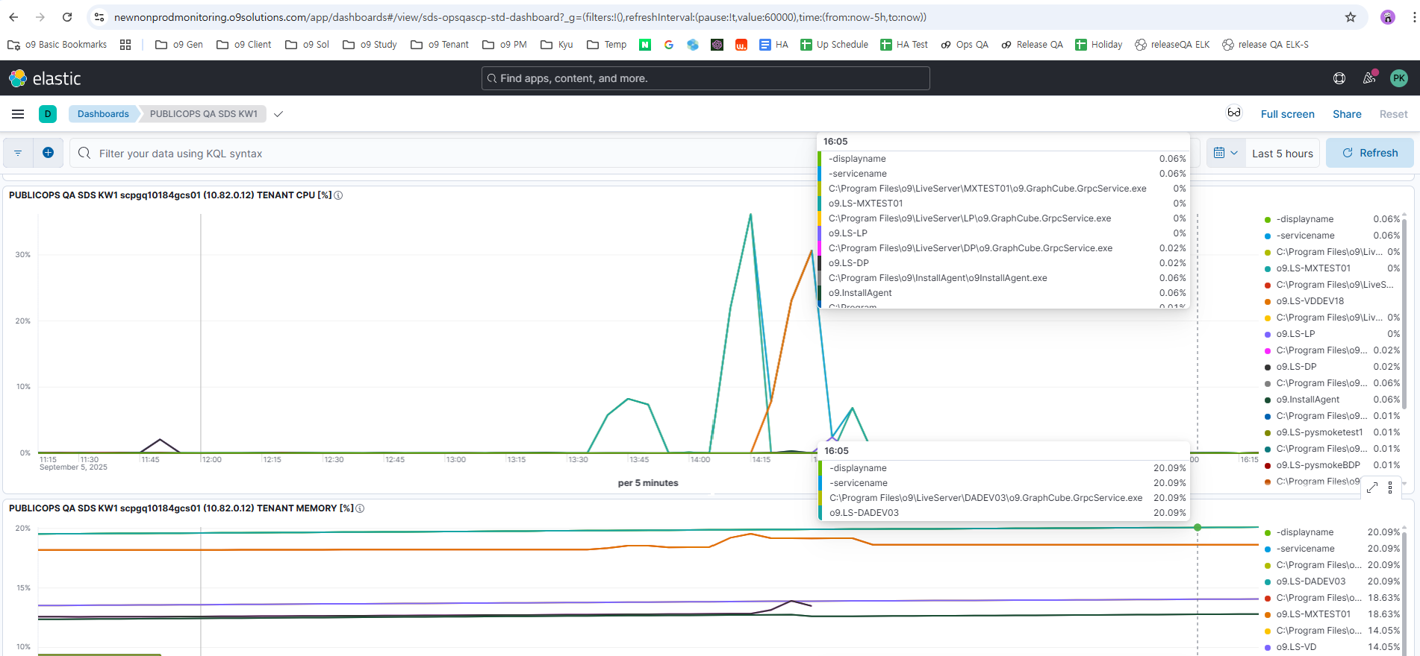
PUBLICOPS QA SDS KW1
Please remove ‘displayname, servicename and c:\Program Files … . As it indicates the same information as tenant name

